Slide 1

pdfOCR+ | pdfSearch
Aykut Avci
Software Development Manager

Slide 2
What is pdfOCR+ | What is pdfSearch ? - Introduction
2 new add-ons to the
iText 7 core Platform
pdf2Data
pdfOCR+
pdfSearch
pdfInvoice
pdfHTML
pdfCalligraph
pdfSweep
pdfXFA
pdfDebug
iText 7 Core

Slide 3

Are you digitizing documents today and why?
What is your current process?

Slide 4
Perception Matrix
Notes:
ArgusSearch for text is already in use in various variants
health insurance companies
education at different universities
for accessing European cultural heritage

Slide 5

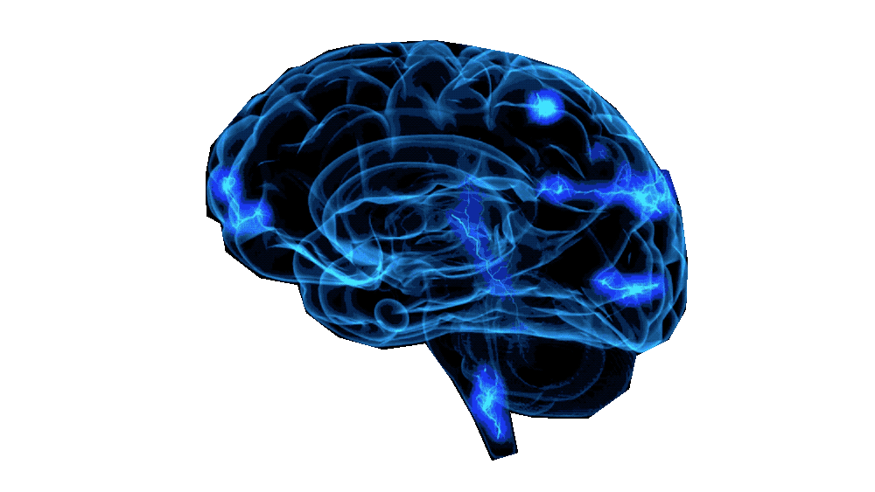
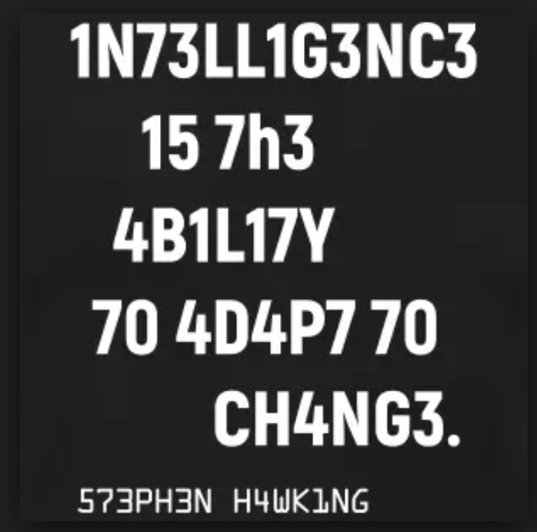
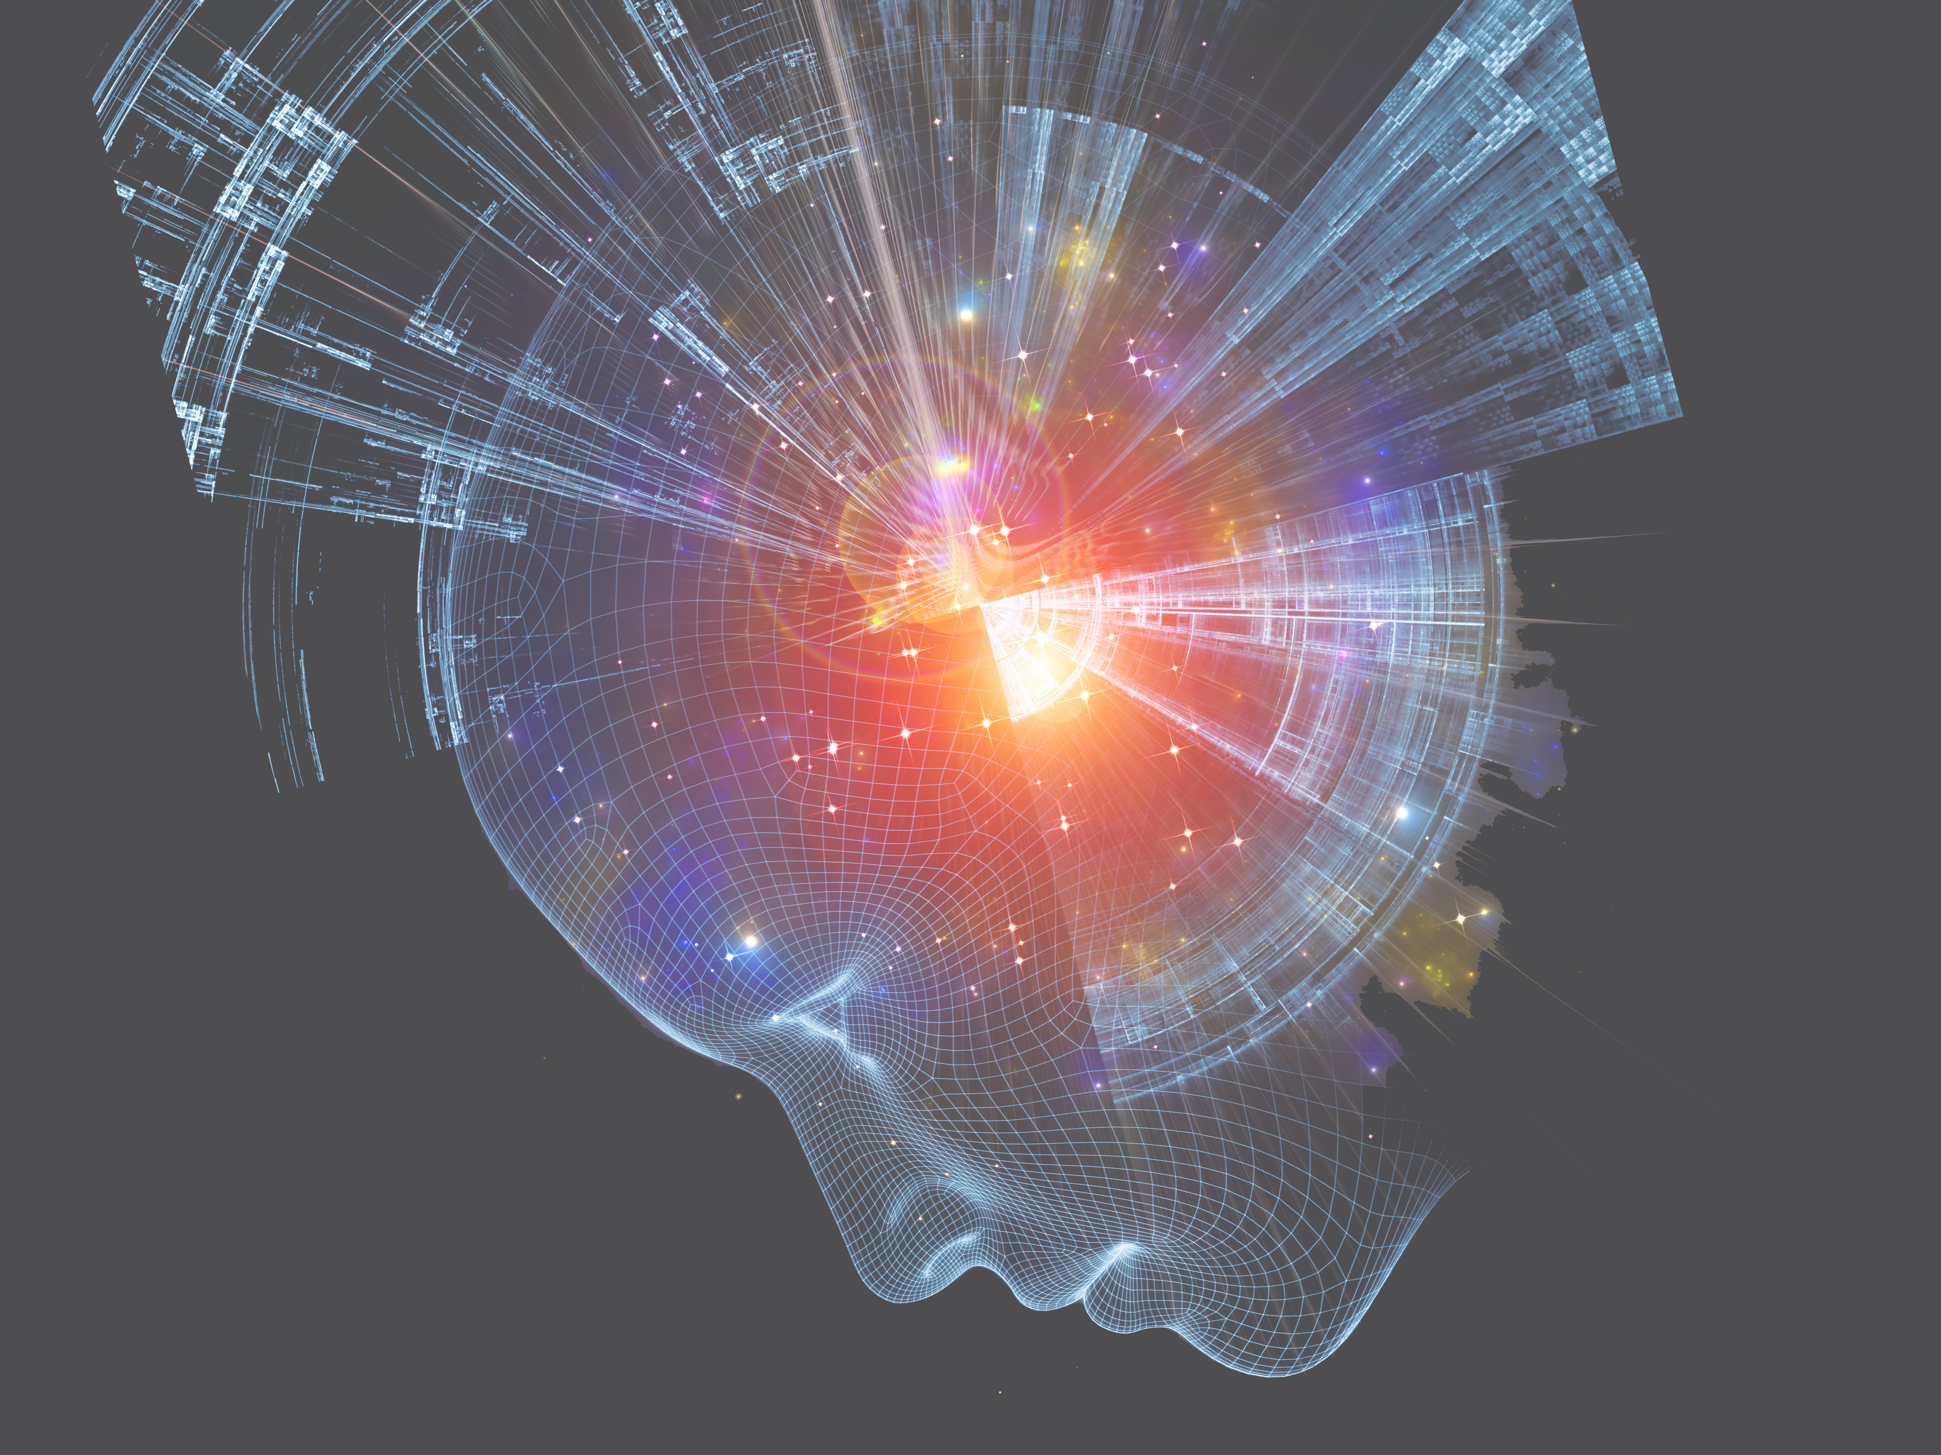
Augmented Memory
Attention
Internal Meaning Representation
PerceptionMatrix
Expectation
Generator
Deep Encoding Scheme
Recurrent Convolutional Layer
Convolutional Layer
Decoding Scheme
Input Sequence
Output Sequence
Notes:
now you really have to use your own head and your own brain!
not only for listening and understanding, but also as an example to understand the principles of biological AI and its inspiration for our models
<Input> imagine you read a book from a fairytale „little red riding hood“ or you listen your Grandfather reading that story - that is the input sequence (either visual or auditive)
<Deep Encoding> without too many details, either through visual or auditive cortex we build up an internal meaning representation
written or spoken „wolf“ will activate same group of neurons in our brain (embeddings)
all objects, actions, relations will be represented by an individual spatio-temporal activation pattern
<Augmented Memory> memorizes these embeddings (internal meaning representations) this is a crucial for all long term relationships, for task planning and causality
<Generator> is the active part, he can start chatting whenever he likes to do so (e.g. important for transcription, translations, question answering, etc)
- attention is a special feature of the generator, because attention guides the focus, e.g. when you ask the question: „Where should we send the huntsman“
all our perception is expectation driven: when Grandfather tells the story the wrong way, we will stop him telling the Grandma eat the wolf bus it was the other way around
expectation is also responsible for all our optical illusions for example
this a sketch of PlanetBrain and how it works in principle, it is universal for all kinds of input data, especially suitable for sequences
the whole system is trainable end to end
(very much like a sequence2sequence system if someone is familiar with that)
But: -> next slide

Slide 6
Augmented Memory
Attention
PDFSearch
PerceptionMatrix
US Patent #15/128, 150
Expectation
Generator
Deep Encoding Scheme
Recurrent Convolutional Layer
Convolutional Layer
Decoding Scheme
Input Sequence
Output Sequence
Notes:
once the system is fully trained, we have a special technology developed (just recently patented) - the PerceptionMatrix
imagine your friend describes a beautiful woman what he met last night in disco - do you think you would be able to recognize her on the street? Probably not!
The problem is, that we can only communicate our perceptions by talking, writing or painting or something like that.
More easy would it be, if you could open the head and directly access the picture of that girl in the brain of your friend - unfortunately this is a bloody mess and he would not like it.
PlanetBrain does not mind, its so friendly, it allows us to directly access its „Internal Meaning Representation“ - we created the PerceptionMatrix.
Well super, and now? What can we do with it?
Let me explain it with a little example:

Slide 7






Search Results
Link to document
Page
Position on page
Image-only PDF contains:
Typewritten content
Handwritten content
Combination of both
Search directly in the perception matrix
No OCR needed or wanted
Search API
Scanned PDF
ML & AI Algorithms
PDF with
Perception
Matrix
Pick 1 interpretation
Assisted by language definition, dictionaries, etc
OCR API
Contains all the possible interpretations, uncertainty, probabilities, etc.
Search Results
PDF with text layer
Standard text extraction, string match search
Notes:
Tradeoff between accuraatheid en speed.
PDF output no Json or Database output

Slide 8
DEMO
Notes:
ArgusSearch for text is already in use in various variants
health insurance companies
education at different universities
for accessing European cultural heritage

Slide 9
use
What do we address?
Letter of complaint
Value +
Complex or Cursive Handwritten Documents
Claims, Expense Reports,
Witness Reports, Testimonials
Invoices, Quotations,
Certificates
Volume +
Printed & Structured
Documents
Forms, Contracts,
Payments

Slide 10




pdfSearch : Capabilities
pdfSearch
Gain Actionable Intelligence
without the need to OCR
Search through digital files containing machine and hand- written text
API allows for easy integration with existing IT environment
Can handle archives of unlimited size
KWS speed: 10.000 pages / sec / CPU
success rate: 97%

Slide 11
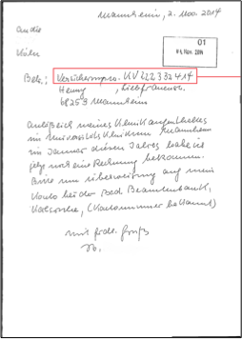
Content Extraction From Documents
Insurance Policy Cancelation Letter
pdfSearch
- Finding content by regular expressions on image only pdf documents
- Keyword search (eg "insurance number")
Notes:
Perception matrix data: uitzoeken hoe het zit tussen pdfOCR and pdfSearch

Slide 12
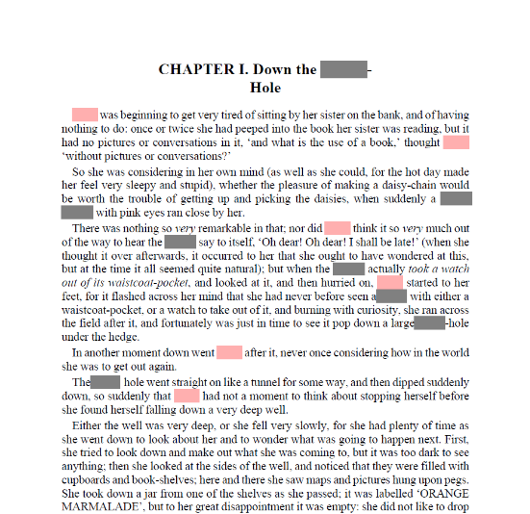
Sweep Out Information From Documents
use
Alice In Wonderland
pdfSearch
pdfSweep
&
Remove sensitive data from a image only PDF files.
Be compliant with EU GDPR and the US Freedom of Information Act (FIA).
Notes:
Permanent highlight

Slide 13
Comes in two flavors: pdfOCR+
Mixed processes that involve handwritten and machine printed documents.
pdfOCR+
Claims
Cancelation Notices
Witness reports | Sworn statement
Enlistment Applications
Consent Forms
Accident reports
Death certificates
Prescriptions
Shipping documents
…
All of pdfOCR
+ All forms of handwriting, including constrained and unconstrained handprint (HTR) and cursive handwriting (HWR)

Slide 14
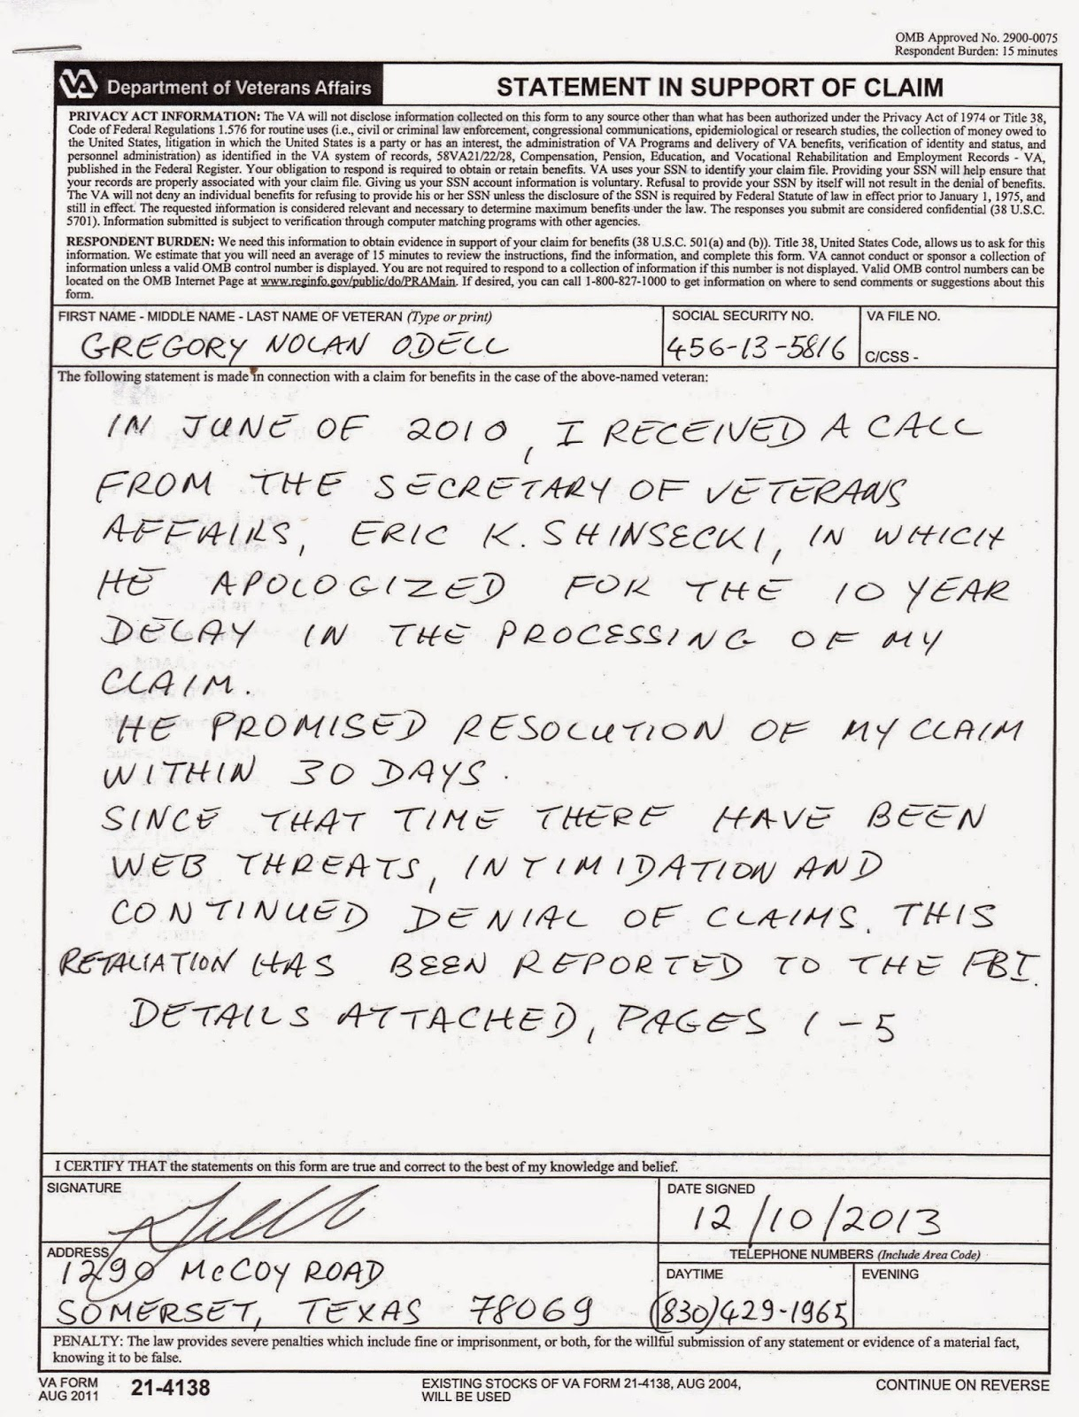
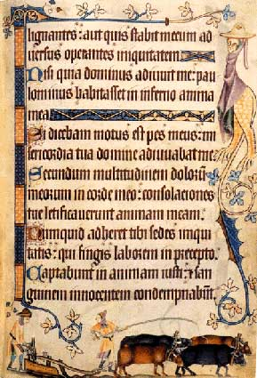
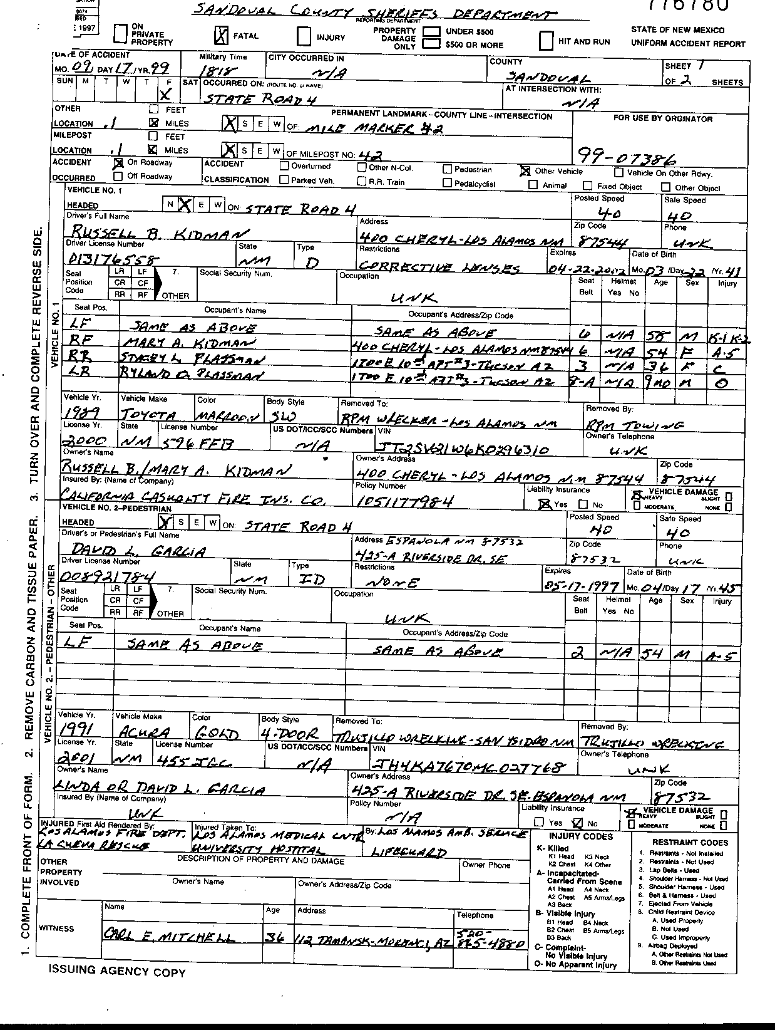
Comes in two flavors: pdfOCR+
use
Claim statement
pdfOCR+
All of pdfOCR
+ All forms of handwriting, including constrained and unconstrained handprint (HTR) and cursive handwriting (HWR)
Manuscripts
Accident Report

Slide 15
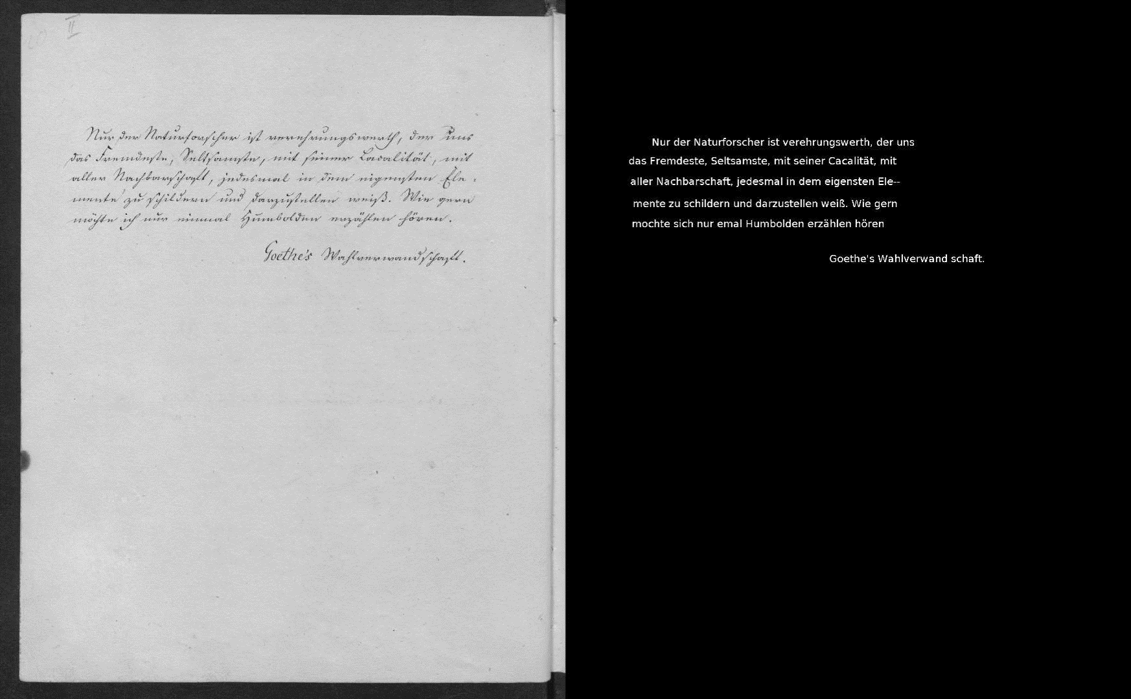
pdfOCR+: Demo
use
pdfOCR+

Slide 16
pdfOCR: Comes in two flavors
pdfOCR
pdfOCR+
Machine Print (any font)
Historical fonts such as ‘Fraktur’, ‘Gothic’, and ‘Sütterlin’
Converts “images of text” to “digital text”
All of pdfOCR
+ All forms of handwriting (HTR), including constrained and unconstrained handprint and cursive handwriting (ICR)

Slide 17
Extract data from documents
use
pdfSearch
pdfOCR+
pdfData
&
&
Search for the document number
OCR the document
Extract data from the document
Accident Report
Notes:
Permanent highlight

Slide 18
use
pdfOCR+ | pdfOCR | pdfSearch
Letter of complaint
pdfOCR+
pdfSearch
Value +
Complex or Cursive Handwritten Documents
Claims, Expense Reports,
Witness Reports, Testimonials
pdfOCR+
pdfSearch
pdfOCR+
pdfSearch
pdfOCR
Invoices, Quotations,
Certificates
Volume +
Printed & Structured
Documents
pdfOCR+
pdfSearch
pdfOCR
Forms, Contracts,
Payments

Slide 19
Next steps?
[ Harness the power of PDF ]

